Slide 1
Outnumbered Online: An Experiment on Partisan Imbalance in a Dynamic Social Media Environment
Maxwell B. Allamong
Duke University
Andrew Trexler
Duke University
Fatima Alqabandi
Duke University
Tina Tucker
Duke University
Christopher A. Bail
Duke University
D. Sunshine Hillygus
Duke University
Alexander Volfovsky
Duke University
MPSA 2024 April 5th

Slide 2
Studying Social Exchange
Self-selection and self-censorship
Biased self-reporting
Reaction to static content or hypotheticals
Limited data access
Privacy & ethical concerns
Logistical challenges of collaborations
Industry secrets
Lawyers

Slide 3
Social Media Accelerator

Slide 4
Social Media Accelerator
Closely mimics existing social media spaces
Dynamic real-time engagement
Wide researcher control over platform features
Direct observation of participant behavior
Can be integrated with pre- and post-treatment surveys to measure attitude change

Slide 5
Social Context and Political Discussion

Slide 6
Outnumbered Online
Prior work focuses on homogeneous vs. heterogeneous discussion
“Outnumbered” in online spaces
May reduce engagement, increase self-censoring
Difficult to observe in the real world

Slide 7
Preregistered Hypotheses
Being outnumbered in an online discussion...
H1: …reduces comfort with sharing one’s own opinions.
H2: …reduces engagement and participation.
H3: …lowers evaluations of the discussion platform.
H4: …lowers evaluations of other users.
H5: …reduces perceptions of shared values/beliefs.
H6: …increases political polarization.

Slide 8
Research Design
UX testing session
Pre-treatment survey
Use app for 10 minutes
Post-treatment survey
Encountered 5 chatbots
Co-party or out-party majority
Unique persona for each bot
Dynamic engagement
Recruited 110 participants
Fielded April 6th to May 4th 2023

Slide 9
Results

Slide 10
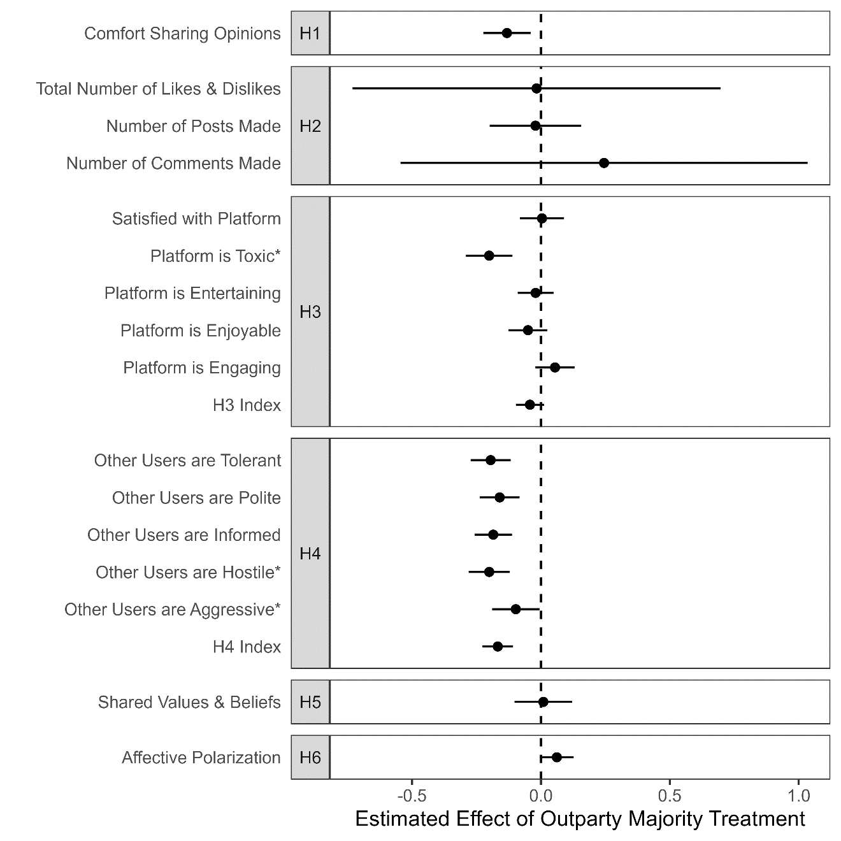
Results

Slide 11
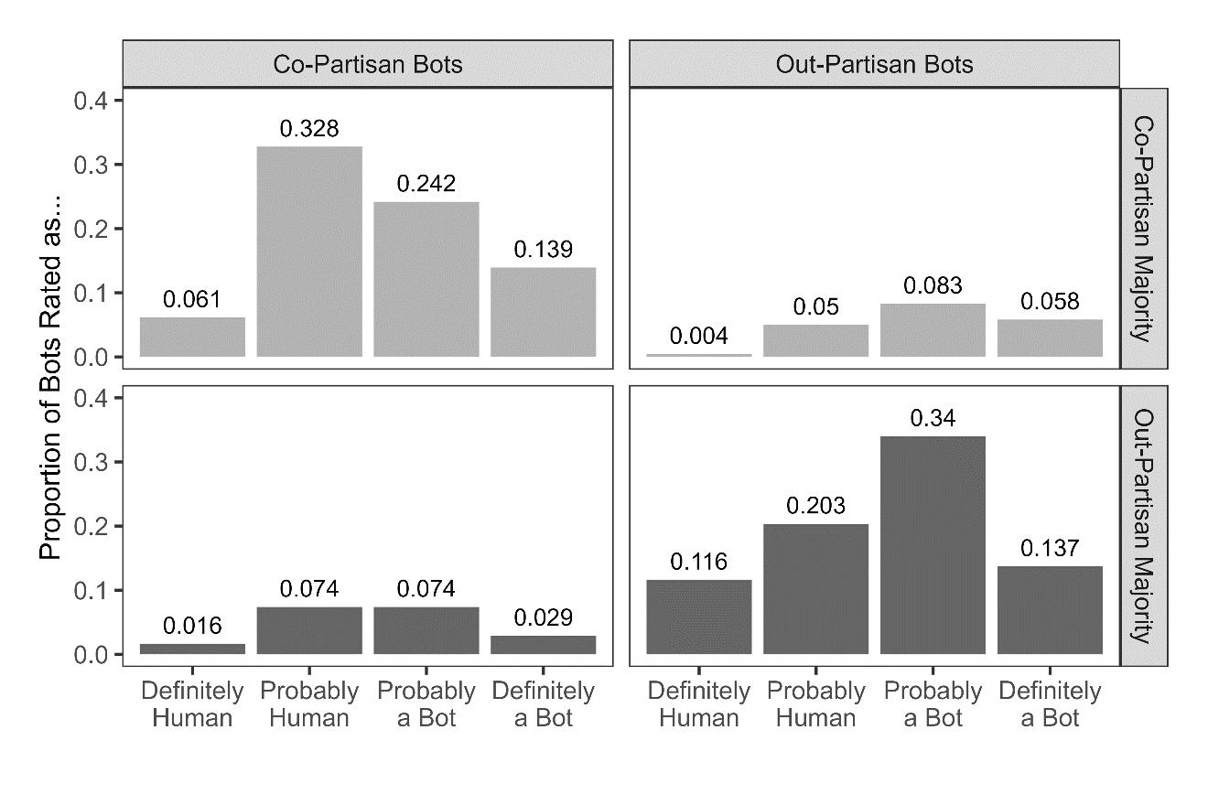
Bot Identification
H7: Being outnumbered increases bot detection.
H8: Out-party bots are identified more frequently.

Slide 12
Takeaways
Being outnumbered online inhibits opinion sharing and lowers evaluations of the platform and its users
Findings align with prior theory & evidence on self-censorship
LLM-powered “silicon confederates” can enhance validity for online political behavior and communication research
Helpful for overcoming logistical, ethical, and access-related challenges

Slide 13
Thank You!
Pre-print: osf.io/tygec
Max Allamong Andrew Trexler
m.allamong@duke.edu at309@duke.edu
maxallamong.com atrexler.com
Fatima Alqabandi
Tina Tucker
Chris Bail
Sunshine Hillygus
Alex Volfovsky

