Slide 1
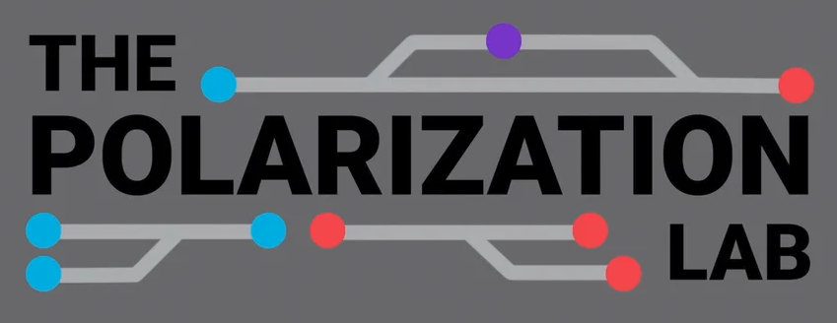

Mass Perceptions of Agency Ideology
Max Allamong, Ph.D.
Postdoctoral Associate

Slide 2
Agency Ideology
Ideology long recognized as an aspect of agency reputation (e.g., Moe 1984)
Reputation crucial to agencies’ ability to fulfill their duties (Carpenter 2010)
But, agency ideology can be hard to measure:
  Proxies such as party of appointing president (Cohen 1986)
  Campaign donations of agency employees (Chen and Johnson 2015)
  Viewpoints of bureaucrats (Clinton et al. 2012)
  Surveys of elites (Richardson, Clinton, and Lewis 2018).

Slide 3
Agency Ideology
Less considered is the perspective of the mass public
Public assesses ideology of various institutions (Hetherington 2001, Jessee and Malhotra 2013)

Slide 4
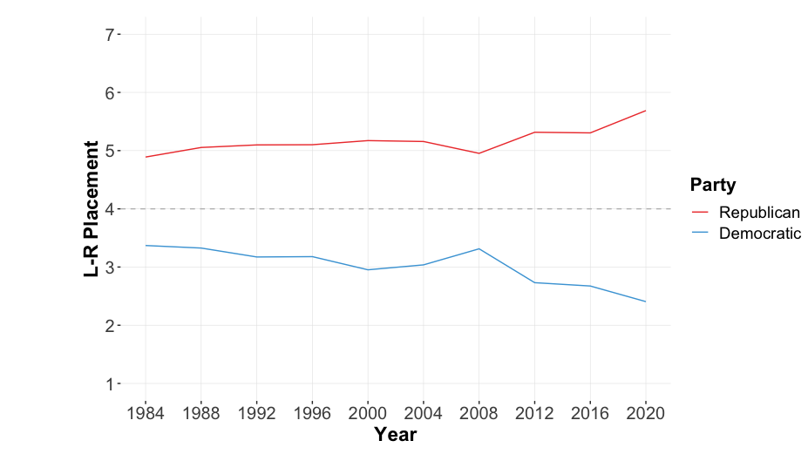
Source: American National Election Studies Cumulative Data File

Slide 5
Agency Ideology
How does the public perceive the ideology of federal agencies?

Slide 6
Data and Methods
2022 CES Module (YouGov, N = 1,000)
2024 Centripetal Force Survey (YouGov, N = 2,000)
  1,500 Government Employees
  500 Civilians
Wording: “Here is a 7-point scale on which the political views that people might hold are arranged from extremely liberal to extremely conservative. Where would you place yourself on this scale, or haven't you thought much about this?”
12 agencies in CES; 15 agencies in CFS

Slide 7
Source: YouGov Centripetal Study

Slide 8
Source: YouGov CES Module

Slide 9
Source: YouGov Centripetal Study
Notes:
USSS

Slide 10
Source: YouGov CES Module

Slide 12
Takeaways
Public sees ideological diversity among federal agencies
Perceptions of agency ideology vary w/ PID
  Partisans see agencies as ideologically opposed
Correlate highly with previous measures

Slide 13
Next Steps
How does the public perceive the ideology of federal agencies?
Why does the public perceive ideological variation across federal agencies?

Slide 14
Next Steps
Political interest?
Bureaucrats vs. public?
Extremists?

